Slide 1
Explainable Machine Learning for Networking (& network security)
Wenbo Guo
Purdue University
Sep 10, 2023

Slide 2
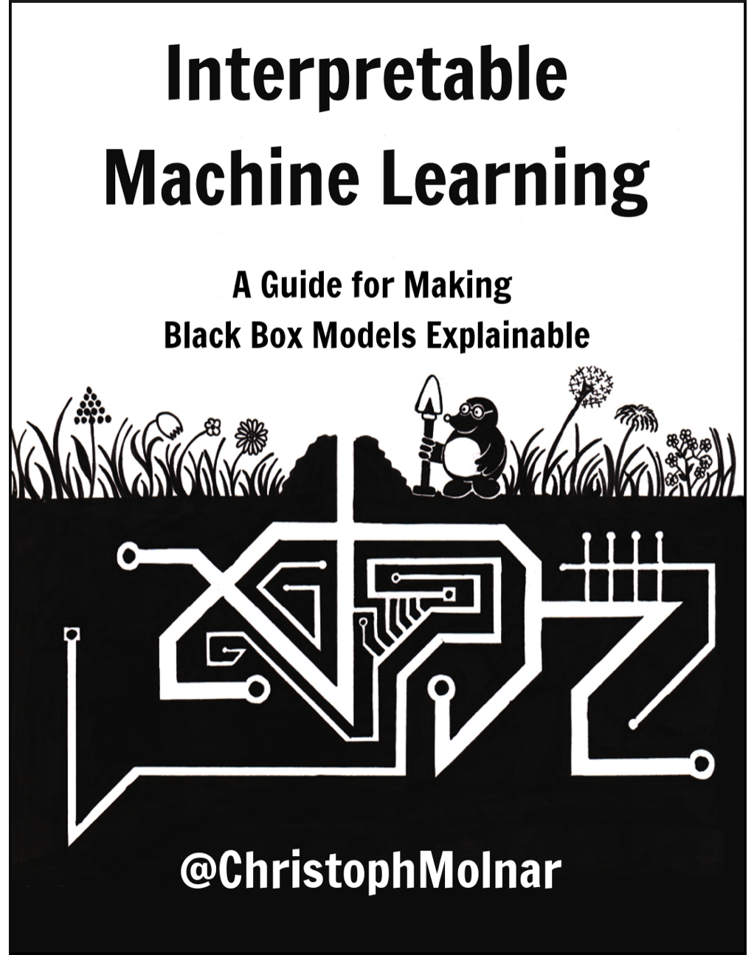
What is Explainable/Interpretable ML?
Interpretable/Explainable Machine Learning refers to methods and models that make the behavior and predictions of machine learning systems understandable to humans
Source: https://christophm.github.io/interpretable-ml-book/

Slide 3
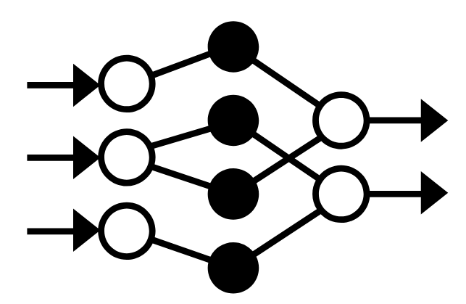





Why we need Explainable ML?
12/02 | Timestamp
7 | Avg. length of sent packets
15 pkt/s | Avg. packet (pkt) sending frequency
Why?!
…
…
Intrusion
Diagnose errors
Build Trust
Patch
errors
Learn new knowledge
Notes:
As we all know, ML-driven security systems output their predictions with explanations. And they need to make critical decisions, for example,
As we can imagine, without explanation of its predictions, security analysts may not trust an ML-driven security system. To make it even worse, when this model makes mistakes, It is hard for security analysts to diagnose the root cause and take proper actions to fix the errors without model explanations.
Due the all these defects, security analysts may not be willing to use ML in reality.
50s

Slide 4
Taxonomy of explanation methods
Intrinsic or post-hoc:
Intrinsic explanation: ML models that can explain their decisions
Linear models, tree-based models
Post-hoc explanation: Explain a pre-trained non-explainable model
Trustee, LIME, LEMNA, etc
Global or local:
Global: Draw an overall explanation from the model
Local: Draw an explanation for each input instance
Sample-level or feature-level:
Sample-level: Identify most representative samples as explanation
Feature-level: Pinpoint most important features as explanation

Slide 5

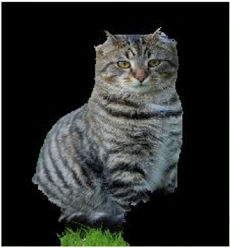
Our focus: Post-hoc feature-level explanation
Given an input testing sample, a well-trained model, and the model output of that input
Explanation: a set of features that make key contributions to the model result
e.g.,
Explanation:
Feature importance
heatmap
Avg. length of sent packets
12/22
7
15 pkt/s
Explanation
…
Avg. packet sending frequency
https://github.com/Henrygwb/Explaining-DL

Slide 6
How to obtain such an explanation
White-box methods - The internal weights of the target deep learning model are accessible
Perturbation-based methods
Gradient-based saliency methods
Black-box methods – Can only observe model outputs
Approximation-based methods
https://github.com/Henrygwb/Explaining-DL
Notes:
Black-box techniques - models that are stored on the cloud.

Slide 7
Perturbation-based methods
High-level idea: Search for a minimum subset of features that preserve the model output when other features are removed
Formulate the process as solving the following objective function
7
15 pkt/s
Perturbed sample
True label
Sparsity
https://github.com/Henrygwb/Explaining-DL

Slide 8
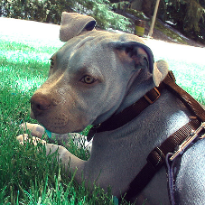
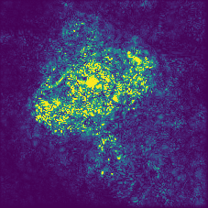
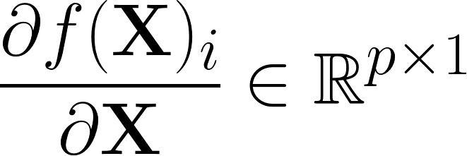
Gradient-based saliency methods
High-level idea:
Utilize the gradient of the model output w.r.t. the input to decide the sensitivity scores (i.e., saliency scores)
Draw the saliency scores as a heatmap (i.e., saliency map)
12/22
7
15 pkt/s
12/22
7
15 pkt/s
…
…
https://github.com/Henrygwb/Explaining-DL

Slide 9
Black-box explanation methods
High-level idea:
Approximate a DL classifier with an explainable model
Draw the important features from the approximation model
The key is about designing proper approximation models to minimize approximation error
Trustee -> Tree-based model
LIME -> Linear regression
LEMNA -> Mixture regression model
https://github.com/Henrygwb/Explaining-DL

Slide 10
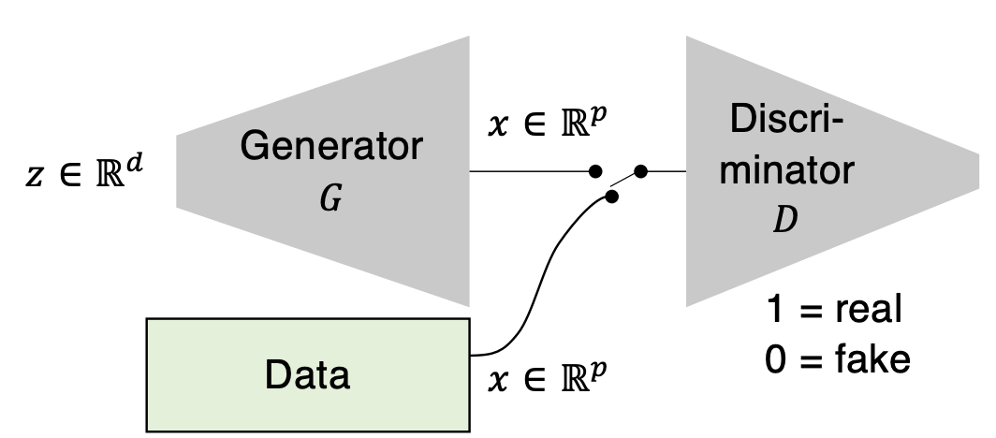
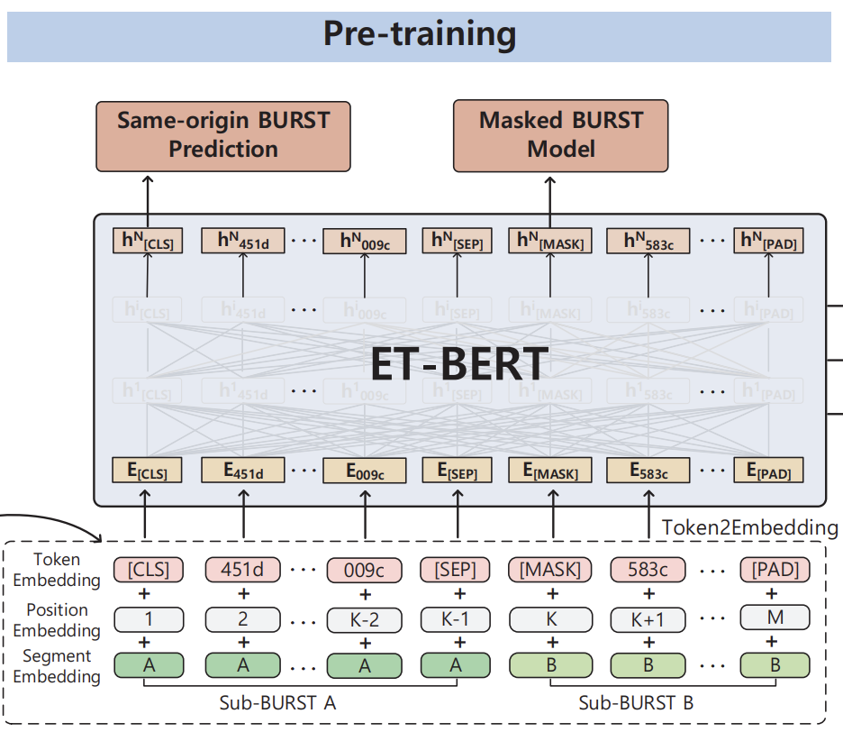
Open challenge: How to explain more complicate models
The networking community leverages advanced methods that cannot be explained by existing methods
Advanced generative models - Generative adversarial nets [1]
How to formulate the explanation
Advanced classification models - Attention-based model [2]
How to leverage attentions to generate explanations
[1] Using GANs for Sharing Networked Time Series Data: Challenges, Initial Promise, and Open Questions
[2] ET-BERT: A Contextualized Datagram Representation with Pre-training Transformers for Encrypted Traffic Classification

Slide 11

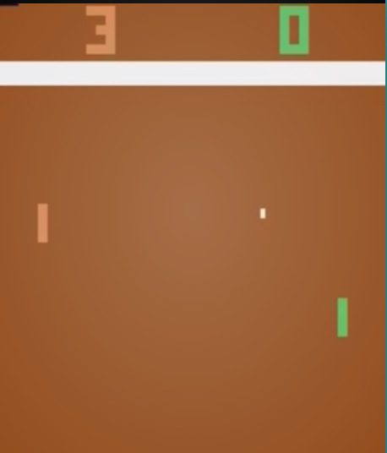
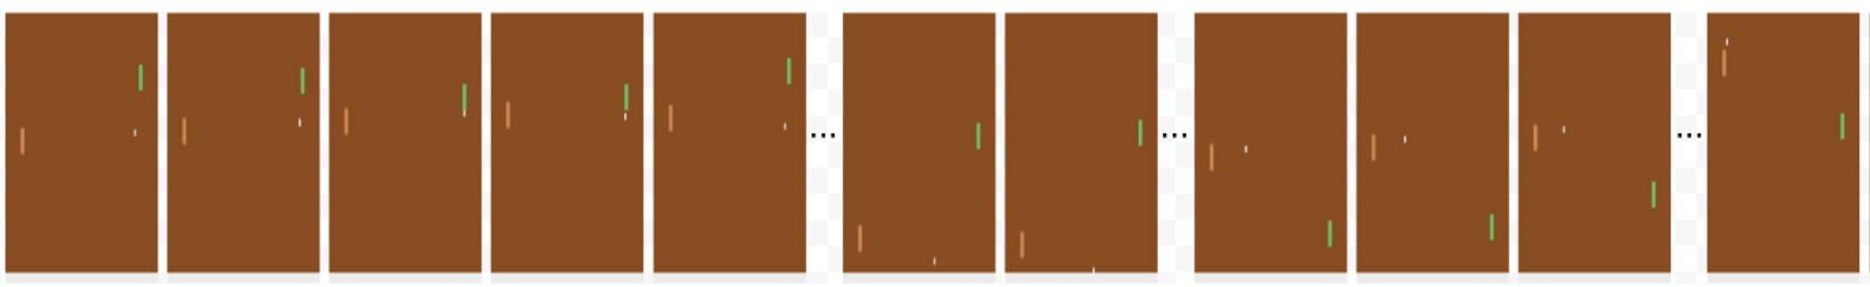

Open challenge: How to explain more complicate models (Cont.)
Reinforcement learning agents
Sequential decision-making models
Existing method can be used to explain individual actions of an agent
How to explain the overall policy of an agent
Why did the agent take this action?
Why did the agent win the game?
What are the important moves?
[1] https://cs.lbl.gov/assets/CSSSP-Slides/20200723-Kiran.pdf

Slide 12
Open challenge: Global vs. local explanations
How to align global with local explanations
Would a majority vote be enough
When to choose between global or local explanations
Whether global explanation exists for large models and how to extract them

Slide 13
Open challenge: How to evaluate explanation methods
Fidelity:
Whether the derived explanation can truly represent the decision-making process of the target model
How to evaluate fidelity without accessing the ground truth
Human understandability:
How to quantify human understandability
Other possible metrics

Slide 14


Open challenge: How to customize explanations for users with different expertise
Current outputs of explanation methods: Important features
Require users with essential expertise to understand the explanation
How to bridge the gap between important features and users without enough expertise
Avg. length of sent packets
12/22
7
15 pkt/s
…
Avg. packet sending frequency
Ordinary People

Slide 15
Open challenge: What are the utilities of explanation
Understand behaviors and establish trust
Explain model errors and fix the errors accordingly
Discover the weaknesses and launch attacks
Robustify model against attacks
…

Slide 16
Other open challenges
There is no universal definition or formalism of explanation
How to build a method that outputs local and global explanations at the same time?
How to build cost-efficient black-box explanation methods?
How to robustify explanation methods from adversarial attacks [1]?
…
[1] DANCE: Enhancing saliency maps using decoys
16

Slide 17
Thank you! Wenbo Guo
A summarization of explainable ML papers
@ https://github.com/Henrygwb/Explaining-DL
henrygwb@purdue.edu
@WenboGuo4
https://henrygwb.github.io/
17
Notes:
Thank you all for the attention. Now I am glad to take questions.

